Slide 1
Soft Computing
CS3EA03

Slide 2
UNIT- 3
Fuzzy Logic: Introduction to Fuzzy logic, Fuzzy sets and membership functions, Operations on Fuzzy sets, Fuzzy relations, rules, propositions, implications and inferences, Defuzzification techniques, Fuzzy logic controller design, Some applications of Fuzzy logic.

Slide 3




INTRODUCTION TO SOFT COMPUTING

Slide 4
Types of computing
1. HARD COMPUTING
2. SOFT COMPUTING
3. HYBRID COMPUTING

Slide 5
Take a example:
Consider a problem where a string
w1 is “abc” and string w2 is “abd”.
Problem-1 : Tell that whether w1 is the same as w2 or not?
Solution – The answer is simply No, it means there is an algorithm by which we can analyze it.

Slide 6
Take a example:
Problem-2 : Tell how much these two strings are similar?
Solution – The answer from conventional computing is either YES or NO. But these maybe 80% similar, this can be answered only by Soft Computing.

Slide 7
Soft computing
The term soft computing was proposed by the inventor of fuzzy logic, Lotfi A. Zadeh
“Soft computing is a collection of methodology that aim to exploit the tolerance of imprecision & uncertainty to achieve tractability, robustness, & low solution on cost. Its principal constituents are fuzzy logic, neuro- Computing & probabilistic reasoning. The role model for soft computing is human mind”
The objective of soft computing is to provide precise approximation and quick solutions for complex real-life problems.

Slide 8
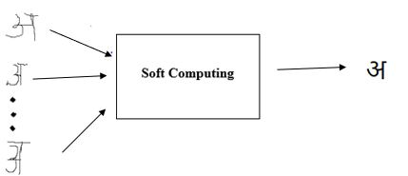
Soft computing

Slide 9
SOFT COMPUTING DEVELOPMENT HISTORY
Soft = Evolutionary + Neural + Fuzzy
Computing Computing Networks Logic
Zadeh Rechenberg Mcculloch Zadeh
1981 1960 1943 1965
Evolutionary = Genetic + Evolution + Evolutionary + Genetic
Computing Programming Strategies Programming Algorithms
Rechenberg Koza Rechenberg Fogel I Iolland
1960 1992 1965 1962 1970

Slide 10
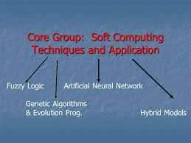
Soft computing techniques

Slide 11
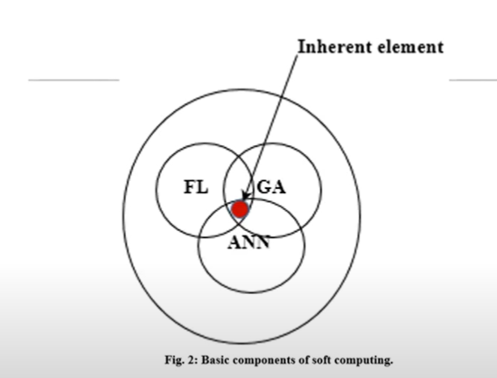

Slide 12
HISTORY OF FUZZY LOGIC
Introduced by Dr. Lotfi A. Zadeh in 1960
Dr. Zadeh present a paper on fuzzy logic in 1965.
.
12

Slide 13
FUZZY
FUZZY- Not Clear.
A form of Knowledge representation suitable for notion that cannot be defined precisely.
Fuzzy logic is a form of multi valued logic derived from fuzzy set theory to deal with reasoning that is approximate rather than accurate.
FUZZY LOGIC

Slide 14
FUZZY LOGIC
Fuzzy logic is the logic underlying approximate, rather than exact, modes of reasoning.
It is an extension of multivalued logic: Everything, including truth, is a matter of degree.
It contains as special cases not only the classical two-value logic and multivalue logic systems, but also probabilistic logic.
Fuzzy logic is a set of mathematical principles for knowledge representation and reasoning based on degrees of membership.
.
14
Notes:
14

Slide 15
Fuzzy Logic
The word fuzzy refers to things which are not clear or are vague.
Fuzzy logic is nothing but mathematical logic which tries to solve problems with an open and imprecise spectrum of data. It makes it easy to obtain an array of precise conclusions.

Slide 16
TRADITIONAL REPRESENTATION OF LOGIC (CRISP)
CRISP
YES
IS RAM HONEST?
NO
16

Slide 17
REPRESENTATION OF FUZZY LOGIC
Extremely Honest
1
FUZZY
Very Honest
0.80
IS RAM HONEST?
Honest at times
0.4
Extremely Dishonest
0
17

Slide 18
Crisp Set
Set
Venn Diagram.
Membership
Cardinality
Null Set/Empty Set
Subset
Superset
Power set
.
18

Slide 19
CLASSICAL SETS (CRISP SETS)
Conventional or crisp sets are binary, an element either belongs to the set or does not.
{True, False}
{1, 0}
.
19

Slide 20
Crisp set
Crisp set is a collection of unordered distinct elements, which are derived from Universal set. Universal set consists of all possible elements which take part in any experiment. Set is quite useful and important way of representing data.
Example :
Classical set of negative integers
Set of persons with height less than 6 feet.
Set of students with passing grades.

Slide 21
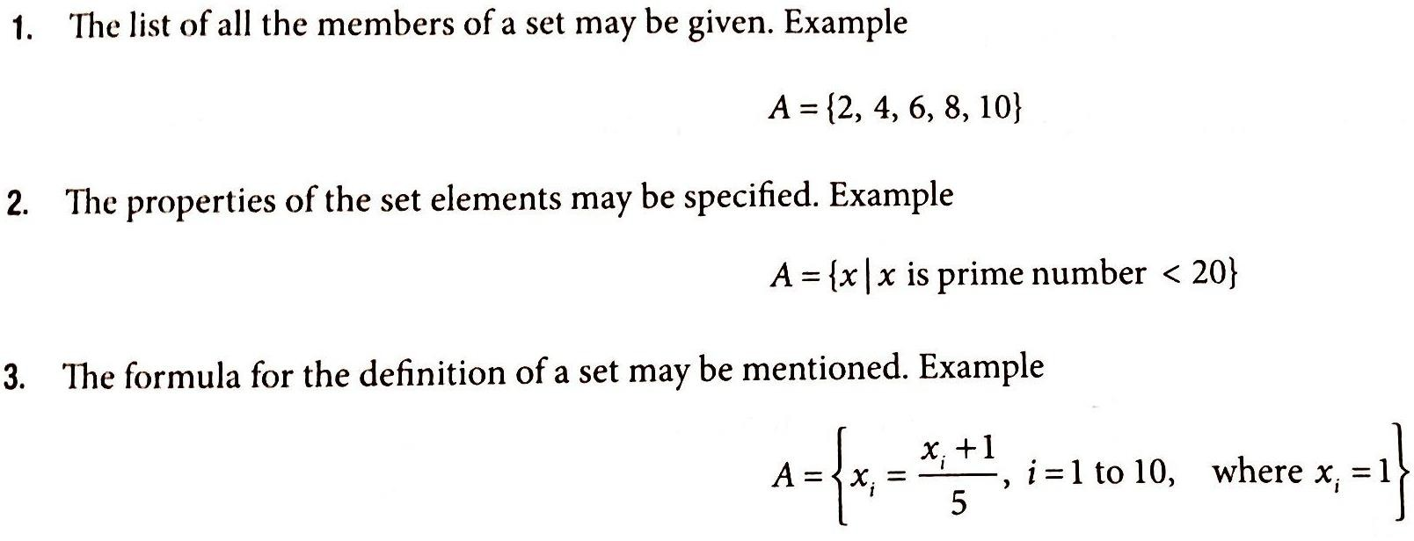
Several other ways of defining set

Slide 22
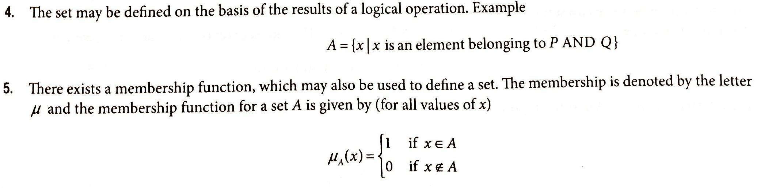
Cont.

Slide 23
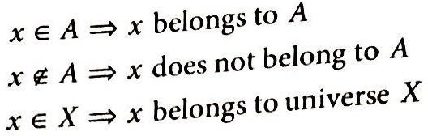
For crisp sets A & B containing some elements in universe X, notations uses as follow :

Slide 24
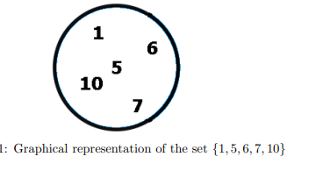
Crisp set
Note that in a set, the order does not matter: 7, 6, 9 denotes the same set as 9, 7, 6

Slide 25
Crisp set
Let X represents a set of natural numbers, so
X = {1, 2, 3, 4, …}
Sets are always defined with respect to some universal set. Let us derive two sets A and B from this universal set X.
A = Set of even numbers = {2, 4, 6, …}
B = Set of odd number = {1, 3, 5, …}

Slide 26
Notations used in Crisp Set
Universe X = {1, 2, 3, 4, 5, 6, 7, 8, 9, 10}
Set A = {2, 4, 6, 8, 10} Set B = {1, 3, 5, 7, 9} Set C = {4, 6, 8}

Slide 27
Some parts of the crisp set
1. Element or Member: x ∈ A represents element x is member of set A.
Set A = {2, 4, 6, 8, 10}
For given data, 2 ∈ A
2. Not a member: x ∉ A represents an element x is not a member of set A.
Set A = {2, 4, 6, 8, 10}
For given data, 3 ∉ A

Slide 28
Some parts of the crisp set
3. Empty set/Null Set : is represented by the symbol, Φ is a set which does not have any element in it. For given data,
D = Φ or D = { }
4. Whole Set:- collection of elements in a universe.
U = {1, 2, 3, 4, 5, 6, 7, 8, 9, 10}

Slide 29
Some parts of the crisp set
5. Cardinal Number:- total number of elements in universe U is called CN.
Denoted by nU
U = {1, 2, 3, 4, 5, 6, 7, 8, 9, 10}
nU = 10
6. Set :- collection of elements in a universe
Set A = {2, 4, 6, 8, 10}

Slide 30
Some parts of the crisp set
7. Subset:- collection of elements within a set
A ⊆ B represents every element of set A is present in set B as well.
In other words, A is subset of B.
For given data, A ⊆ X
Universe X = {1, 2, 3, 4, 5, 6, 7, 8, 9, 10}
Set A = {2, 4, 6, 8, 10}

Slide 31
Some parts of the crisp set
8. Superset:- A ⊇ B represents every element of B is member of set A as well.
In other words, A is superset of B.
For given sets, A ⊇ C
Set A = {2, 4, 6, 8, 10} Set B = {1, 3, 5, 7, 9} Set C = {4, 6, 8}

Slide 32
Some parts of the crisp set
9. Proper subset:- A ⊂ B represents every element of A is in B as well as B has some additional element which is not in A. This notation says that A is proper subset of B.
(A is completely contained in B).
Example:
Set A = {2, 4, 6, 8, 10}
Set B = {2, 4, 6, 8, 10,12,14}

Slide 33
Some parts of the crisp set
10. Proper superset:- A ⊃ B represents all the elements of B are in set A as well as A has some additional element which is not in B. This notation says that A is proper superset of B.
Example:-
Set A = {2, 4, 6, 8, 10,12,14,16,18}
Set B = {2, 4, 6, 8, 10}

Slide 34
Some parts of the crisp set
11. Equal set:- if set A and B are identical then we can say A is subset of B or B is subset of A.
A = B represents Equal sets,
i.e. sets A and B have identical elements
Set A = {2, 4, 6, 8, 10} Set B = {2, 4, 6, 8, 10}
A ≠ B represents Not equal sets,
i.e. sets A and B have different elements.
Set A = {2, 4, 6, 8, 10,12} Set B = {2, 4, 6, 8, 10}

Slide 35
Some parts of the crisp set
Singleton Sets
A set that has only one element is called a singleton set or also called a unit set.
Example, Set A = { k | k is an integer between 3 and 5} which is A = {4}.

Slide 36
Some parts of the crisp set
Finite Sets
As the name implies, a set with a finite or countable number of elements is called a finite set. Example, Set B = {k | k is a prime number less than 20}, which is B = {2,3,5,7,11,13,17,19}

Slide 37
Some parts of the crisp set
Infinite Sets
A set with an infinite number of elements is called an infinite set. Example: Set C = {Multiples of 3}.
Equivalent Sets
Two sets are said to be equivalent sets when they have the same number of elements, though the elements are different. Example: A = {1,2,3,4} and B = {a,b,c,d}. Here, set A and set B are equivalent sets since n(A) = n(B)

Slide 38
Some parts of the crisp set
Disjoint Sets
Two sets are disjoint sets if there are no common elements in both sets. Example: A = {1,2,3,4} B = {5,6,7,8}. Here, set A and set B are disjoint sets.

Slide 39
Some parts of the crisp set
Overlapping Sets
Two sets are said to be overlapping if at least one element from set A is present in set B. Example: A = {2,4,6} B = {4,8,10}. Here, element 4 is present in set A as well as in set B. Therefore, A and B are overlapping sets.

Slide 40
Some parts of the crisp set
12. Cardinality:- number of elements in set.
For given Set A = {2, 4, 6, 8, 10}
|A|= 5
13. Power set:- set which consists of all possible subsets of a given set is called power set.
p(A) represents Power set of set A.
For the given set c = { 4,6,8}
p(c) = { Φ, {4}, {6}, {8}, {4, 6}, {4, 8}, {6, 8}, {4, 6, 8} }

Slide 41
Some parts of the crisp set
14. Membership Function:- A membership function (also called indicator function or characteristic function) is a function that explicit membership or not a set.
Element or Member: x ∈ A represents element x is member of set A.
Set A = {2, 4, 6, 8, 10}
For given data, 2 ∈ A

Slide 42
Some parts of the crisp set
15. Venn Diagram:- Graphical/ Pictorial representation of set.

Slide 43



OPERATIONS ON CRISP SETS
UNION:
INTERSECTION:
COMPLEMENT:
DIFFERENCE:
.
43

Slide 44
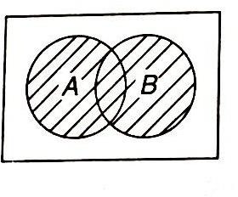
Operation on Classical set
1) Union : The union between two sets gives all those elements in the universe that belongs to either set A or set B or both sets A & B. Union can be termed as logical OR operations.
Union of two sets A & B is given as A U B = { x | x Є A or x Є B }
eg :

Slide 45
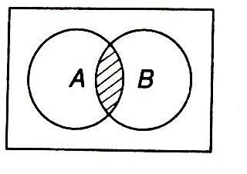
2) Intersection
Intersection between two sets represents all those elements in the universe that simultaneously belongs to both the sets. Intersection also known as logical AND.
A ∩ B = { x | x Є A or x Є B}
Eg :

Slide 46
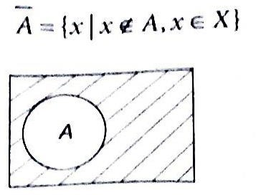
Complement
The complement of set A is defined as collection of all elements in universe X that donot reside in set A i.e., the entities that do not belong to A. Denoted as Ᾱ and is defined as

Slide 47
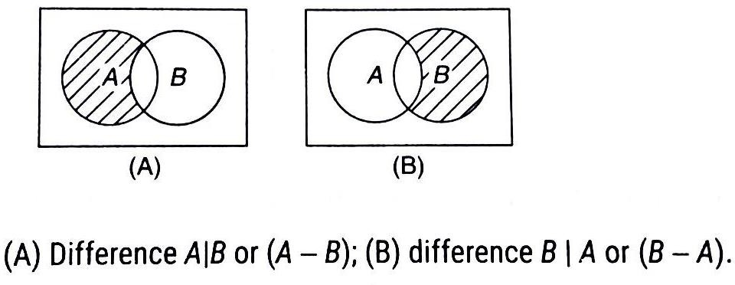
Difference ( Subtraction )
The difference of set A with respect to set b is collection of all elements in the universe that belongs to A but do not belong to B i.e., the difference set consists of all elements that belong to A but donot belong to B. Denoted as A | B or A-B and given as

Slide 48
Classical set operation example
Let us understand various operations on set with the help of example. We will consider following data to execute various operations:
X = {1, 2, 3, 4, 5, 6, 7, 8, 9}
A = {1, 2, 3, 4, 5}
B = {3, 4, 5, 6}
C = {6, 7, 8, 9}

Slide 49
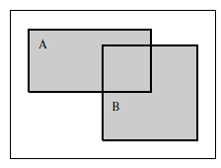
Set operations
1. Union:- Union of sets is the collection of all the elements which are either in A or in B. Common elements from both the sets are considered only once. Mathematically, we can represent union operation as follow:
A ∪ B = { x | x ∈ A or x ∈ B }

Slide 50
union
Let us understand various operations on set with the help of example. We will consider following data to execute various operations:
X = {1, 2, 3, 4, 5, 6, 7, 8, 9}
A = {1, 2, 3, 4, 5}
B = {3, 4, 5, 6}
C = {6, 7, 8, 9}
A ∪ B={1, 2, 3, 4, 5, 6}

Slide 51
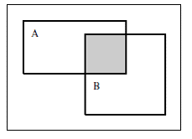
Classical set operation example
2. Intersection:- Intersection of sets is the collection of all the common elements from set A and B. Mathematically, we can represent union operation as follow:
A ∩ B = { x | x ∈ A and x ∈ B }

Slide 52
intersection
Let us understand various operations on set with the help of example. We will consider following data to execute various operations:
X = {1, 2, 3, 4, 5, 6, 7, 8, 9}
A = {1, 2, 3, 4, 5}
B = {3, 4, 5, 6}
C = {6, 7, 8, 9}
A ∩ B = {3, 4, 5}

Slide 53
Classical set operation example
3. complement:- Complement operation is always represented with respect to some set. If complement is performed with respect to universal set, then it is called absolute complement.
Complement of set A is collection of all the elements which are not in A but are in the universal set.
Mathematically,
A’ = A^{c} = X – A = { x | x ∈ X and x ∉ A }

Slide 54

Classical set operation example
Let us understand various operations on set with the help of example. We will consider following data to execute various operations:
X = {1, 2, 3, 4, 5, 6, 7, 8, 9}
A = {1, 2, 3, 4, 5}
B = {3, 4, 5, 6}
C = {6, 7, 8, 9}
A’ = {6, 7, 8, 9}

Slide 55
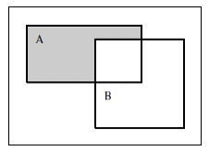
Classical set operation example
4. Difference:- Difference of set A with respect to set B is collection of all the elements in A but not in B. It is also known as relative complement.
A – B = { x | x ∈ A and x ∉ B }

Slide 56
difference
X = {1, 2, 3, 4, 5, 6, 7, 8, 9}
A = {1, 2, 3, 4, 5}
B = {3, 4, 5, 6}
A – B = {1, 2}
B-A={6}

Slide 57
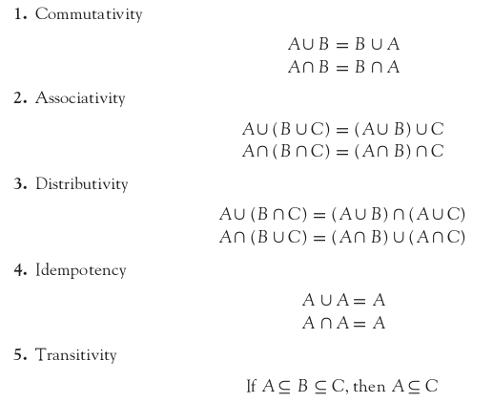
PROPERTIES OF CRISP SETS
The various properties of crisp sets are as follows:
.
57

Slide 58
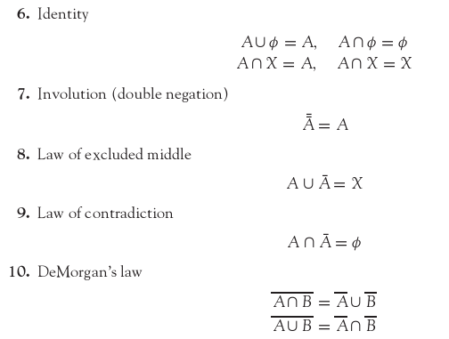
58

Slide 59
Crisp set properties:
Crisp set possesses various properties.
We will demonstrate each of them with suitable example.
X = {1, 2, 3, 4, 5, 6}
A = {1, 2, 3},
B = {2, 3, 4},
C = {5, 6}

Slide 60
Crisp set properties:
1. Commutativity:- property states that the operation can be performed irrespective of order of the operand. For example, addition is commutative operator, so 2 + 3 or 3 + 2 yields the same result.
Proving union is commutative:
A ∪ B = {1,2,3} ∪{2,3,4} = {1, 2, 3, 4} → LHS
B ∪ A = {2,3,4} ∪ {1,2,3} = {1, 2, 3, 4} → RHS
Proving intersection is commutative:
A ∩ B = {1,2,3} ∩ {2,3,4} = {2, 3} → LHS
B ∩ A = ∩ {2, 3} → RHS

Slide 61
Crisp set properties:
2. Associativity: Associativity property allows us to perform the operations by grouping the operands and keeping them in similar order.
(A ∪ B) ∪ C= A ∪ ( B ∪ C )
For given data: X = {1, 2, 3, 4, 5, 6}
A = {1, 2, 3}, B = {2, 3, 4}, C = {5, 6}
A ∪ B = {1, 2, 3, 4}, B ∪ C = {2, 3, 4, 5, 6}
A ∪ (B ∪ C) → RHS
{1,2,3} ∪ {2, 3, 4, 5, 6} ) = {1, 2, 3, 4, 5, 6}
(A ∪ B) ∪ C → LHS
{1, 2, 3, 4} ) ∪ {5,6} ={1, 2, 3, 4, 5, 6}

Slide 62
Crisp set properties:
Intersection_- (A ∩ B) ∩ C= A ∩ ( B ∩ C)
For given data: A = {1, 2, 3}, B = {2, 3, 4}, C = {5, 6}
A ∩ B = {2, 3}, B ∩ C = ϕ
A ∩ (B ∩ C) = ϕ → LHS
{1,2,3} ∩ ϕ= ϕ
(A ∩ B) ∩ C = ϕ → RHS
{2, 3} ∩ {5,6} = ϕ

Slide 63
Crisp set properties:
3. Distributive
A ∪ (B ∩ C) = (A ∪ B) ∩ (A ∪ C)
B ∩ C = ϕ
A ∪ (B ∩ C) = {1, 2, 3} ∪ ϕ = {1, 2, 3} →LHS
A ∪ B = {1, 2, 3, 4}
A ∪ C = {1, 2, 3, 5, 6}
(A ∪ B) ∩ (A ∪ C) = {1, 2, 3, 4} ) ∩ {1, 2, 3, 5, 6}
= {1, 2, 3} → RHS
A ∩ (B ∪ C) = (A ∩ B) ∪ (A ∩ C)
B ∪ C = {2, 3, 4, 5, 6}
A ∩ (B ∪ C) = {1,2,3} ∩ {2, 3,4,5,6} = {2,3,} → LHS
A ∩ B = {2, 3}
A ∩ C = ϕ
(A ∩ B) ∪ (A ∩ C) = {2, 3} ∪ ϕ
= {2, 3} → RHS

Slide 64
Crisp set properties:
4. Idempotency is defined as,
For given data: X = {1, 2, 3, 4, 5, 6}
A = {1, 2, 3}, B = {2, 3, 4}, C = {5, 6}
A ∪ A = A
A ∩ A = A
For the given data,
A ∪ A = {1, 2, 3} ∪ {1, 2, 3} = {1, 2, 3} = A
A ∩ A = {1, 2, 3} ∩ {1, 2, 3} = {1, 2, 3} = A

Slide 65
Crisp set properties:
5. Transitivity: Mathematically, we can define this property as,
If A ⊆ B and B ⊆ C, then A ⊆ C
A = {1, 2, 3}, B = {1, 2, 3, 4}, C = {1,2,3,4,5, 6}

Slide 66
Crisp set properties:
6. Identity:- Mathematically, we can define this property as,
A ∪ X = X
A ∩ X = A
A ∪ ϕ = A
A ∩ ϕ = ϕ

Slide 67
Crisp set properties:
For the given data, X = {1, 2, 3, 4, 5, 6}
A = {1, 2, 3}, B = {2, 3, 4}, C = {5, 6}
1. A ∪ X ={1,2,3} ∪ {1, 2, 3, 4, 5, 6} = {1, 2, 3, 4, 5, 6} X
2. A ∩ X = {1, 2, 3} ∩ {1, 2, 3, 4, 5, 6} ={1, 2,3} = A
3. A ∪ ϕ = {1, 2, 3} ∪ ϕ = {1, 2, 3} = A
4. A ∩ ϕ = {1, 2, 3} ∩ ϕ = ϕ

Slide 68
Crisp set properties:
7. Involution states that the complement of complement of set A would be set A it self.
For given data, X = {1, 2, 3, 4, 5, 6}
A = {1, 2, 3}, B = {2, 3, 4}, C = {5, 6}
A’ = X – A = {1, 2, 3, 4, 5, 6} - {1, 2, 3} = {4, 5, 6}
(A’)’ = X – A’ = {1, 2, 3, 4, 5, 6} - {4, 5, 6}
= {1, 2, 3} = A

Slide 69
Crisp set properties:
8. Law of excluded middle:- Mathematically it is defined as,
A ∪ A’ = X
For the given data, X = {1, 2, 3, 4, 5, 6}
A = {1, 2, 3}, B = {2, 3, 4}, C = {5, 6}
A’ = X – A = {1, 2, 3, 4, 5, 6} - {1, 2, 3} = {4, 5, 6} A ∪ A’ ={1,2,3} ∪ {4, 5, 6} = {1, 2, 3, 4, 5, 6} = X

Slide 70
Crisp set properties:
9. Law of Contradiction: Mathematically it is defined as,
A ∩ A’ = ϕ
For the given data: X = {1, 2, 3, 4, 5, 6}
A = {1, 2, 3}, B = {2, 3, 4}, C = {5, 6}
A’ = X – A = {1, 2, 3, 4, 5, 6} - {1, 2, 3} = {4, 5, 6}
A ∩ A’ = {1,2,3} ∩ {4, 5, 6} = { } = ϕ

Slide 71
De Morgan’s law
10. De Morgan’s Law is a collection of boolean algebra transformation rules that are used to connect the intersection and union of sets using complements.

Slide 72
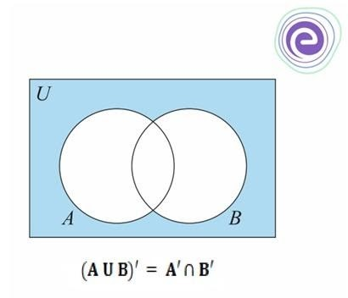
De Morgan’s First Law
10.1 It states that the complement of the union of any two sets is equal to the intersection of the complement of that sets
Consider any two sets A and B, the mathematical relation of De Morgan’s first law is given by
(AUB)′=A′∩ B′

Slide 73
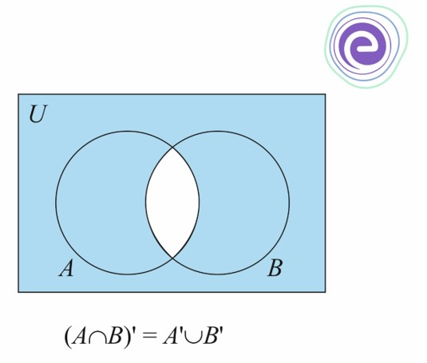
De Morgan’s Second Law
9.2 It states that the complement of the intersection of any two sets is equal to the union of the complement of that sets.
Consider any two sets A and B, the mathematical relation of De Morgan’s second law is given by
(A∩B)′=A′∪ B’

Slide 74
Function Mapping of Classical Sets
Mapping is a rule of correspondence between set-theoretic forms to function- theoretic forms.
In its most general form it can be used to map elements or subsets on one universe of discourse to elements or sets in another universe.
If an element x is contained in set X and corresponds to an element y contained in set Y, it is generally termed a mapping from X to Y,
f : X →Y

Slide 75


Function Mapping of Classical Sets
The characteristic (indicator) function χ_{A} is defined by
Membership function is a mapping for crisp set A.

Slide 76
Function Mapping of Classical Sets
Example : a universe with three elements, X = {a, b, c}, we desire to map the elements of the power set of X, i.e., P(X), to a universe, Y, consisting of only two elements (the characteristic function), Y = {0, 1}
the elements of the power set? the elements in the value set V(P(X))?

Slide 77
Function Mapping of Classical Sets
Example : a universe with three elements, X = {a, b, c}, we desire to map the elements of the power set of X, i.e., P(X), to a universe, Y, consisting of only two elements (the characteristic function), Y = {0, 1}
the elements of the power set
P(X) = {∅, {a}, {b}, {c}, {a, b}, {b, c}, {a, c}, {a, b, c}}
the elements in the value set V(P(X))
V{P(X)} = {{0, 0, 0}, {1, 0, 0}, {0, 1, 0}, {0, 0, 1}, {1, 1, 0}, {0, 1, 1}, {1, 0, 1}, {1, 1, 1}}

Slide 78
Function Mapping of Classical Sets
The union of these two sets in terms of function-theoretic terms is given as follows (the symbol ∨ is the maximum):
Union A ∪ B −→ χA∪B(x) = χA(x) ∨ χB(x) = max(χA(x), χ B(x))
The intersection of these two sets in function-theoretic terms is given by (the
symbol ∧ is the minimum operator):
Intersection A ∩ B −→ χA∩B(x) = χA(x) ∧ χB(x) = min(χA(x), χB(x))
The complement of a single set on universe X, say A, is given by

Slide 79
HISTORY OF FUZZY LOGIC
Introduced by Dr. Lotfi A. Zadeh in 1960
Dr. Zadeh present a paper on fuzzy logic in 1965.
.
79

Slide 80
FUZZY
FUZZY- Not Clear.
A form of Knowledge representation suitable for notion that cannot be defined precisely.
Fuzzy logic is a form of multi valued logic derived from fuzzy set theory to deal with reasoning that is approximate rather than accurate.
FUZZY LOGIC

Slide 81
FUZZY LOGIC
Fuzzy logic is the logic underlying approximate, rather than exact, modes of reasoning.
It is an extension of multivalued logic: Everything, including truth, is a matter of degree.
It contains as special cases not only the classical two-value logic and multivalue logic systems, but also probabilistic logic.
Fuzzy logic is a set of mathematical principles for knowledge representation and reasoning based on degrees of membership.
.
81
Notes:
81

Slide 82
Fuzzy Logic
The word fuzzy refers to things which are not clear or are vague.
Fuzzy logic is nothing but mathematical logic which tries to solve problems with an open and imprecise spectrum of data. It makes it easy to obtain an array of precise conclusions.

Slide 83
TRADITIONAL REPRESENTATION OF LOGIC (CRISP)
CRISP
YES
IS RAM HONEST?
NO
83

Slide 84
REPRESENTATION OF FUZZY LOGIC
Extremely Honest
1
FUZZY
Very Honest
0.80
IS RAM HONEST?
Honest at times
0.4
Extremely Dishonest
0
84

Slide 85
Fuzzy Sets
Fuzzy set support flexible sense of membership of element to a set.
In crisp set theory an element “ belongs to” or “ not belongs ‘ a set .
In fuzzy set theory many degrees of membership (between 0 and 1) are allowed.
85

Slide 86
Fuzzy Set
Fuzzy set may be viewed as an extension & generalization of
the basic concepts of crisp sets.
Important property of fuzzy set is it allows partial membership.
Fuzzy set is set having degrees of membership between 1 & O. The membership in a fuzzy set need not be complete i.e. member of one fuzzy seet can also be member of other fuzzy sets in the same universe.
Eg: If a person has to be classified as friend or enemy, intelligent people will not resort to absolute classification as friend or enemy.
Rather they will classify person somewhere between two
extremes of friendship and enmity.
Similary, vagueness is introduced in fuzzy set by eliminating the sharp boundaries that divides members from nonmember in group.

Slide 87
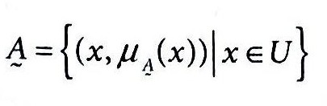
Cont.
A fuzzy set in the universe of discourse U can be defined as set of ordered pairs & given as :

Slide 88
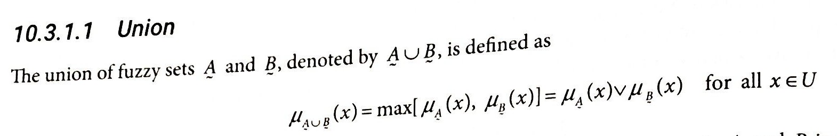
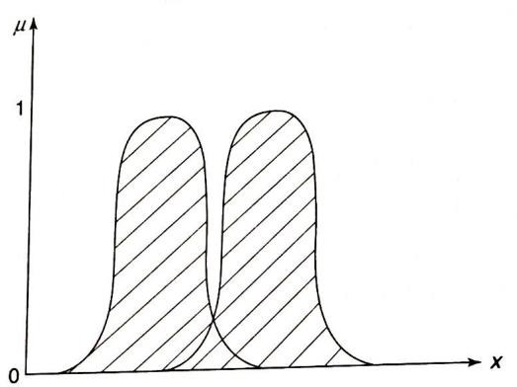
Fuzzy set Operations
Union : Let A & B be fuzzy sets in the universe of discourse U
•

Slide 89
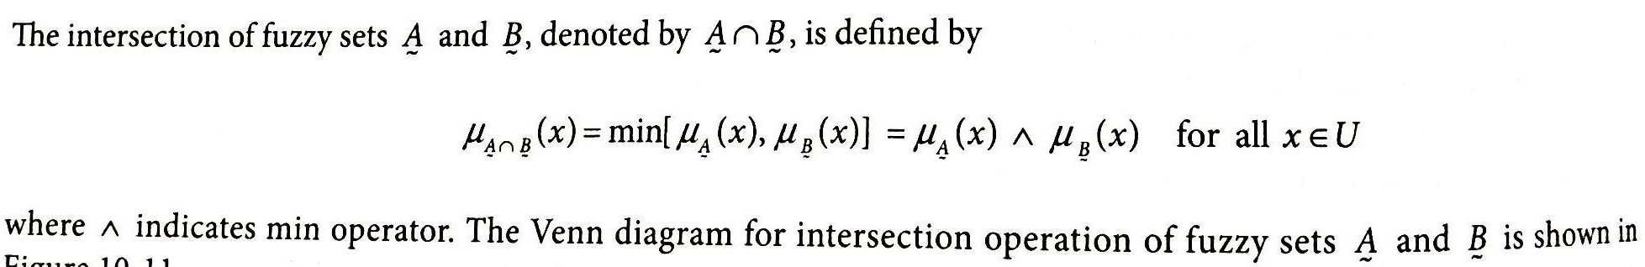
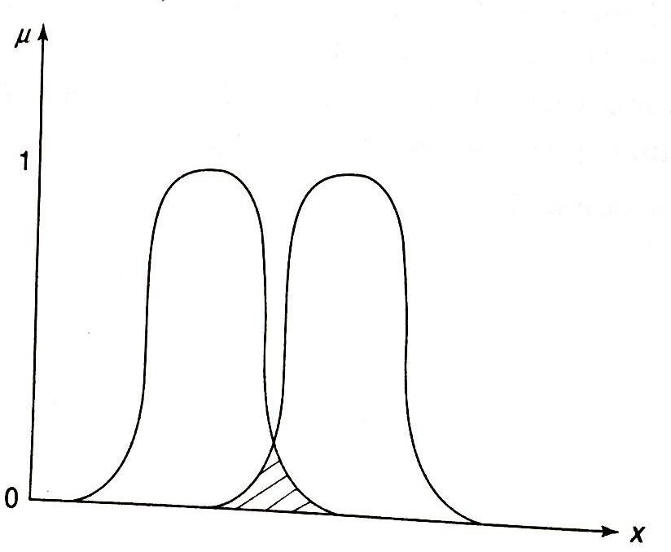
Intersection

Slide 90
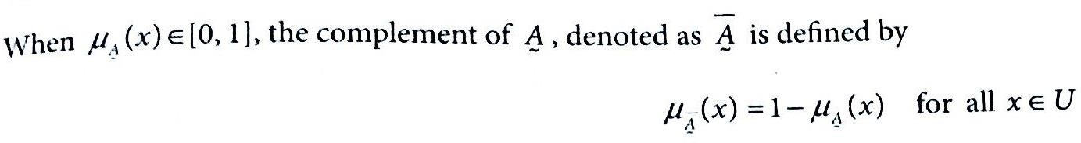
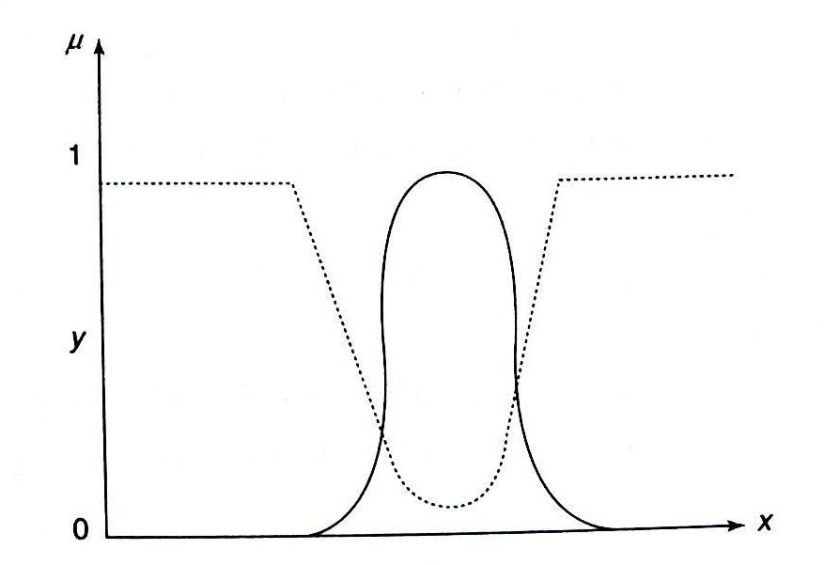
Complement

Slide 91
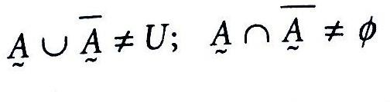
Properties of Fuzzy sets
Fuzzy set follow same properties as crisp sets except law of excluded middle and law of contradiction . That is for fuzzy set

Slide 92
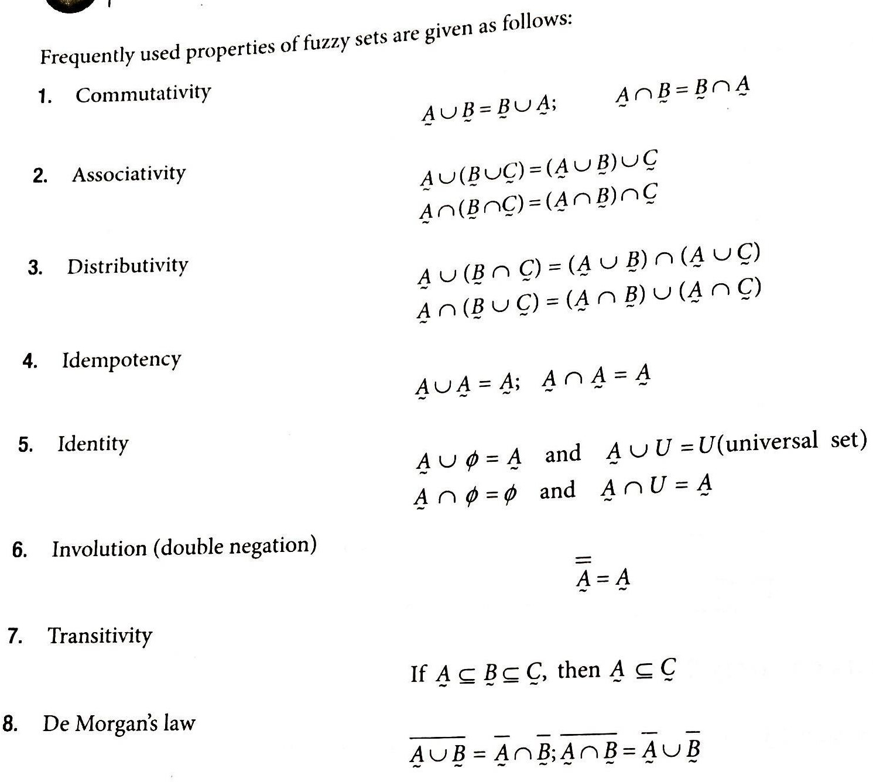

Slide 93
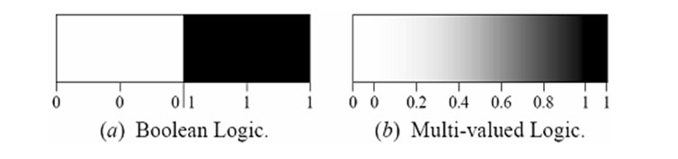
Fuzzy Sets vs Crisp Sets
93

Slide 94
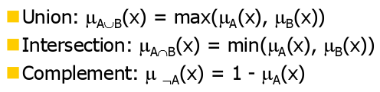
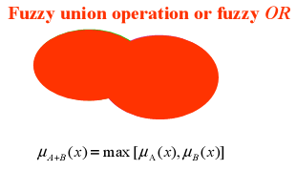
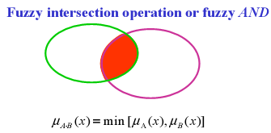
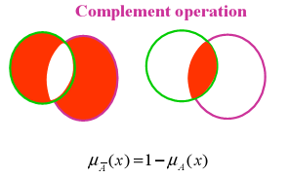
OPERATIONS ON FUZZY SETS
94

Slide 95


Product of Two Fuzzy Sets
The product of two fuzzy sets A & B is a new fuzzy set A.B with membership function:
Product of Fuzzy Sets with a Crisp Number
Multiplying a fuzzy set A by a crisp number ‘n’ results in a new fuzzy set n. A, whose membership function is

Slide 96

Power of a Fuzzy Set
The alpha power of a fuzzy set A is a new fuzzy set A^{α} whose membership function is: that is, individual memberships power of α
Difference of Fuzzy Sets
The differences of two fuzzy sets A and B is a new fuzzy set A-B which is defined as
Disjunctive Sum of A & B
It is the new fuzzy set defined as follow:

Slide 97
Examples of Fuzzy Set Operations
Fuzzy union (∪): the union of two fuzzy sets is the maximum (MAX) of each element from two sets.
E.g.
A = {1.0, 0.20, 0.75}
B = {0.2, 0.45, 0.50}
A ∪ B = {MAX(1.0, 0.2), MAX(0.20, 0.45), MAX(0.75, 0.50)} = {1.0, 0.45, 0.75}

Slide 98
Examples of Fuzzy Set Operations
Fuzzy intersection (∩): the intersection of two fuzzy sets is just the MIN of each element from the two sets.
E.g. A ∩ B = {MIN(1.0, 0.2), MIN(0.20, 0.45), MIN(0.75, 0.50)} = {0.2, 0.20, 0.50}

Slide 99
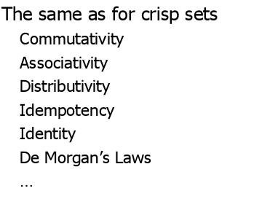
PROPERTIES OF FUZZY SETS
99

Slide 100
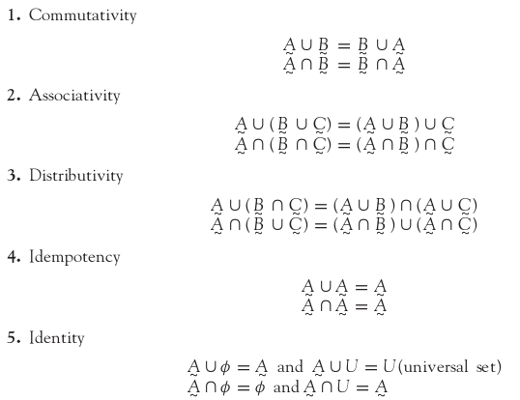
100

Slide 101
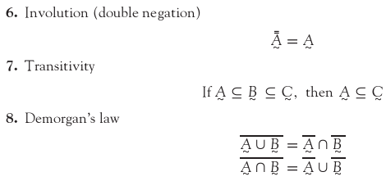
101

Slide 102
Relation is of fundamental importance in all – engineering science and mathematically based field. Relation are involved in logic, approximate reasoning ,classification, rule based system, pattern recognition and control.
In Crisp relation there are only two degrees of relationship between the elements of set in crisp relation, that is “completely related” and “ not related”.
Fuzzy relations are a generalization of crisp binary relations, and they allow various degrees of relationship (association) between elements.
RELATIONS
102

Slide 103
CRISP RELATIONS
To understand the fuzzy relations, it is better to discuss first crisp relation.
Suppose, A and B are two (crisp) sets.
Then Cartesian product denoted as A × B is a collection of order pairs, such that
A × B = {(a, b)|a ∈ A and b ∈ B}
Note :
A × B != B × A
A × B| = |A| × |B|
A × B provides a mapping from a ∈ A to b ∈ B. The mapping so mentioned is called a relation.
103

Slide 104
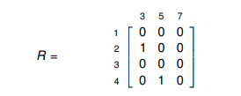
Example 1: Consider the two crisp sets A and B as given below.
A ={ 1, 2, 3, 4}
B = {3, 5, 7 }.
Then, A × B = {(1, 3),(1, 5),(1, 7),(2, 3),(2, 5),(2, 7),(3, 3),(3, 5), (3, 7),(4, 3),(4, 5),(4, 7)}
Let us define a relation R as R = {(a, b)|b = a + 1,(a, b) ∈ A × B}
Then, R = {(2, 3),(4, 5)} in this case.
We can represent the relation R in a matrix form as follows.

Slide 105
Operations on Crisp Relations
Suppose, R(x, y) and S(x, y) are the two relations define over two crisp sets x ∈ A and y ∈ B
Union: R(x, y) ∪ S(x, y) = max(R(x, y), S(x, y));
Intersection: R(x, y) ∩ S(x, y) = min(R(x, y), S(x, y));
Complement: R(x, y) = 1 − R(x, y)

Slide 106
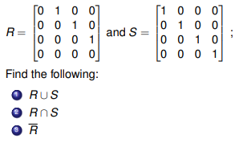
Example: Suppose, R(x, y) and S(x, y) are the two relations define over two crisp sets x ∈ A and y ∈ B

Slide 107
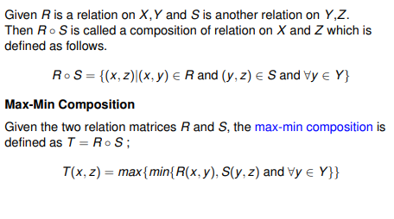
Composition of two crisp relations

Slide 108
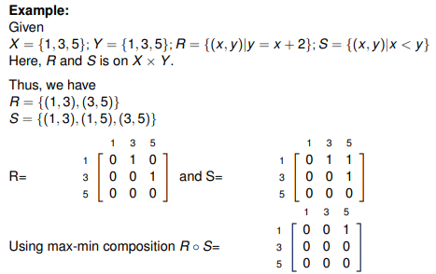

Slide 109
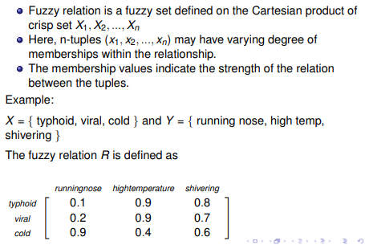
Fuzzy Relations

Slide 110
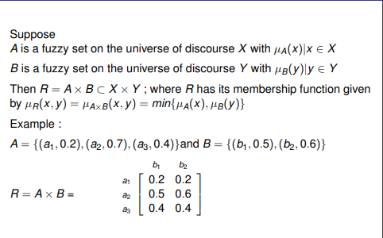
Fuzzy Cartesian Product

Slide 111
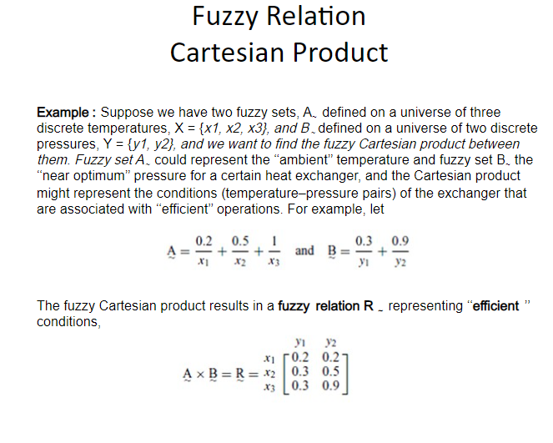

Slide 112
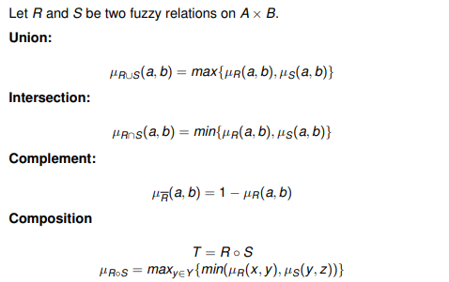
Operations on Fuzzy Relations

Slide 113
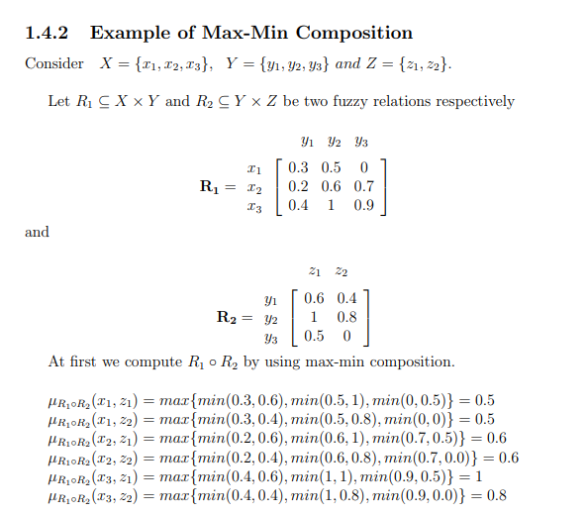

Slide 114
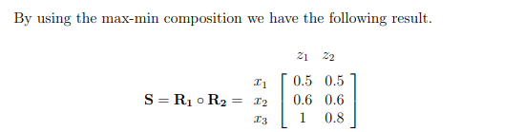

Slide 115
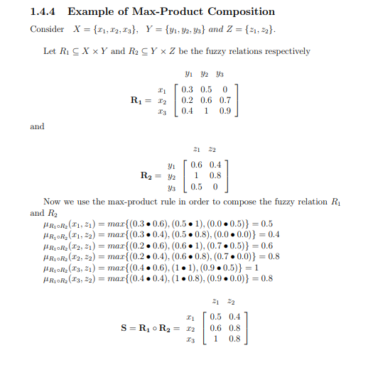

Slide 116


Max-Max Composition:-
Min-Min Composition:-

Slide 117
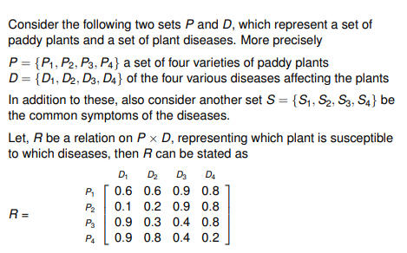
Fuzzy Relation : An Example

Slide 118
FUZZY RULES
A fuzzy rule is defined as the conditional statement of the form
If x is A
THEN y is B
where x and y are linguistic variables and A and B are linguistic values determined by fuzzy sets on the universal set X and Y.
118

Slide 119
FUZZY RULE - EXAMPLE
Rule 1: If height is short then weight is light.
Rule 2: If height is medium then weight is medium.
Rule 3: If height is tall then weight is heavy.
.
119

Slide 120
Problem: Given
(a) membership functions for short, medium-height, tall, light, medium-weight and heavy;
(b) The three fuzzy rules;
the fact that John’s height is 5’1”
estimate John’s weight.
120

Slide 121
Solution:
(1) From John’s height we know that
John is short (degree 0.3)
John is of medium height (degree 0.6).
John is tall (degree 0.2).
(2) Each rule produces a fuzzy set as output by truncating the consequent membership function at the value of the antecedent membership.
.
121

Slide 122
De-fuzzify to obtain a numerical estimate of the output.
Choose the middle of the range where the truth value is maximum.
John’s weight = 80 Kg.
122

Slide 123
Interpretations of Fuzzy IF-THEN Rules
Fuzzy IF-THEN Rules can be interpreted in the following forms −
Assignment Statements
These kinds of statements use “=” (equal to sign) for the purpose of assignment. They are of the following form −
a = hello
climate = summer
Conditional Statements
These kinds of statements use the “IF-THEN” rule base form for the purpose of condition. They are of the following form −
IF temperature is high THEN Climate is hot
IF food is fresh THEN eat.
Unconditional Statements
They are of the following form −
GOTO 10
turn the Fan of

Slide 124
Linguistic Variable
Fuzzy logic uses linguistic variables which are the words or sentences in a natural language. For example, if we say temperature, it is a linguistic variable; the values of which are very hot or cold, slightly hot or cold, very warm, slightly warm, etc. The words very, slightly are the linguistic hedges.

Slide 125
Propositions in Fuzzy Logic
Propositions are sentences expressed in any language which are generally expressed in the following canonical form −
s as P
Here, s is the Subject and P is Predicate.
For example, “Delhi is the capital of India”, this is a proposition where “Delhi” is the subject and “is the capital of India” is the predicate which shows the property of subject.
Logic is the basis of reasoning and fuzzy logic extends the capability of reasoning by using fuzzy predicates, fuzzy-predicate modifiers, fuzzy quantifiers and fuzzy qualifiers in fuzzy propositions which creates the difference from classical logic.

Slide 126
Propositions in fuzzy logic include the following
Fuzzy Predicate
Almost every predicate in natural language is fuzzy in nature hence, fuzzy logic has the predicates like tall, short, warm, hot, fast, etc.
Fuzzy-predicate Modifiers
We discussed linguistic hedges above; we also have many fuzzy-predicate modifiers which act as hedges. They are very essential for producing the values of a linguistic variable. For example, the words very, slightly are modifiers and the propositions can be like “water is slightly hot.”
Fuzzy Quantifiers
It can be defined as a fuzzy number which gives a vague classification of the cardinality of one or more fuzzy or non-fuzzy sets. It can be used to influence probability within fuzzy logic. For example, the words many, most, frequently are used as fuzzy quantifiers and the propositions can be like “most people are allergic to it.”

Slide 127
Fuzzy Qualifiers
Let us now understand Fuzzy Qualifiers. A Fuzzy Qualifier is also a proposition of Fuzzy Logic. Fuzzy qualification has the following forms −
Fuzzy Qualification Based on Truth
It claims the degree of truth of a fuzzy proposition.
Expression − It is expressed as x is t. Here, t is a fuzzy truth value.
Example − (Car is black) is NOT VERY True.
Fuzzy Qualification Based on Probability
It claims the probability, either numerical or an interval, of fuzzy proposition.
Expression − It is expressed as x is λ. Here, λ is a fuzzy probability.
Example − (Car is black) is Likely.
Fuzzy Qualification Based on Possibility
It claims the possibility of fuzzy proposition.
Expression − It is expressed as x is π. Here, π is a fuzzy possibility.
Example − (Car is black) is Almost Impossible.

Slide 128
FUZZY INFERENCE SYSTEMS (FIS)
Fuzzy rule based systems, fuzzy models, and fuzzy expert systems are also known as fuzzy inference systems.
The key unit of a fuzzy logic system is FIS.
The primary work of this system is decision-making.
FIS uses “IF...THEN” rules along with connectors “OR” or “AND” for making necessary decision rules.
The input to FIS may be fuzzy or crisp, but the output from FIS is always a fuzzy set.
128

Slide 129
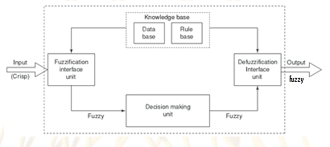
BLOCK DIAGRAM OF FIS
129

Slide 130
FUZZY EXPERT SYSTEMS
An expert system contains three major blocks:
Knowledge base that contains the knowledge specific to the domain of application.
Inference engine that uses the knowledge in the knowledge base for performing suitable reasoning for user’s queries.
User interface that provides a smooth communication between the user and the system.
130

Slide 131
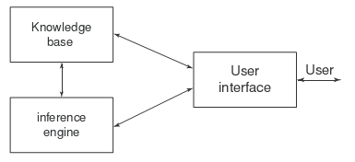
BLOCK DIAGRAM OF FUZZY EXPERT SYSTEMS
.
131

Slide 132
Thank you

